Slide 1
Supervised Learning
PE29 Vasu Kalariya
PE30 Sakshi Patil
PE14 Payal Patil
PE16 Vaishanvi Salunke

Slide 2
Machine Learning
“Learning is any process by which a system improves performance from experience.” - Herbert Simon
Machine Learning by Tom Mitchell
Machine Learning is the study of algorithms that
improve their performance P
at some task T
with experience E.

Slide 3
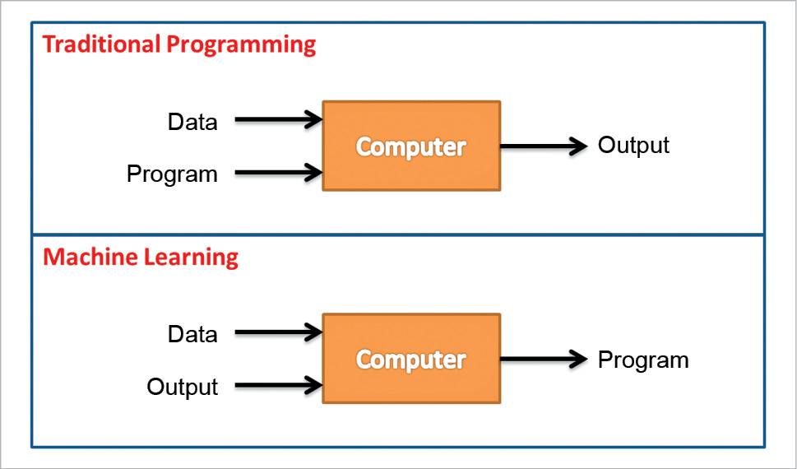

Slide 4
Types of Learning
Supervised (inductive) learning
Given: training data + desired outputs (labels)
Unsupervised learning
Given: training data (without desired outputs)
Semi-supervised learning
Given: training data + a few desired outputs

Slide 5
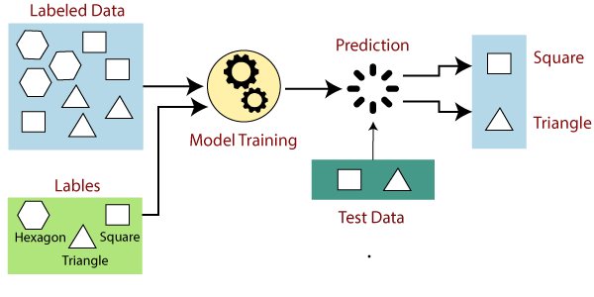
How Supervised Learning Works?

Slide 6
Steps Involved in Supervised Learning:
Determine
First Determine the type of training dataset
Collect/Gather
Collect/Gather the labelled training data.
Split
Split the training dataset into training dataset, test dataset, and validation dataset.
Determine
Determine the input features of the training dataset, which should have enough knowledge so that the model can accurately predict the output.
Determine
Determine the suitable algorithm for the model
Execute
Execute the algorithm on the training dataset.
Evaluate
Evaluate the accuracy of the model by providing the test set. If the model predicts the correct output, which means our model is accurate.

Slide 7
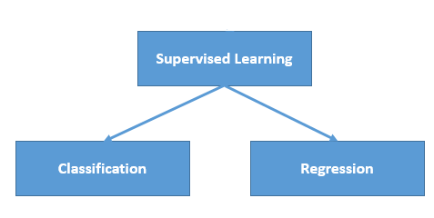
Types of supervised Machine learning Algorithms:

Slide 8
Advantages of Supervised learning
With the help of supervised learning, the model can predict the output on the basis of prior experiences.
In supervised learning, we can have an exact idea about the classes of objects.
Supervised learning model helps us to solve various real-world problems such as fraud detection, spam filtering, etc.

Slide 9
Disadvantages of supervised learning
Supervised learning models are not suitable for handling the complex tasks.
Supervised learning cannot predict the correct output if the test data is different from the training dataset.
Training required lots of computation times.
In supervised learning, we need enough knowledge about the classes of object.

Slide 10

Thank you

